Slide 1
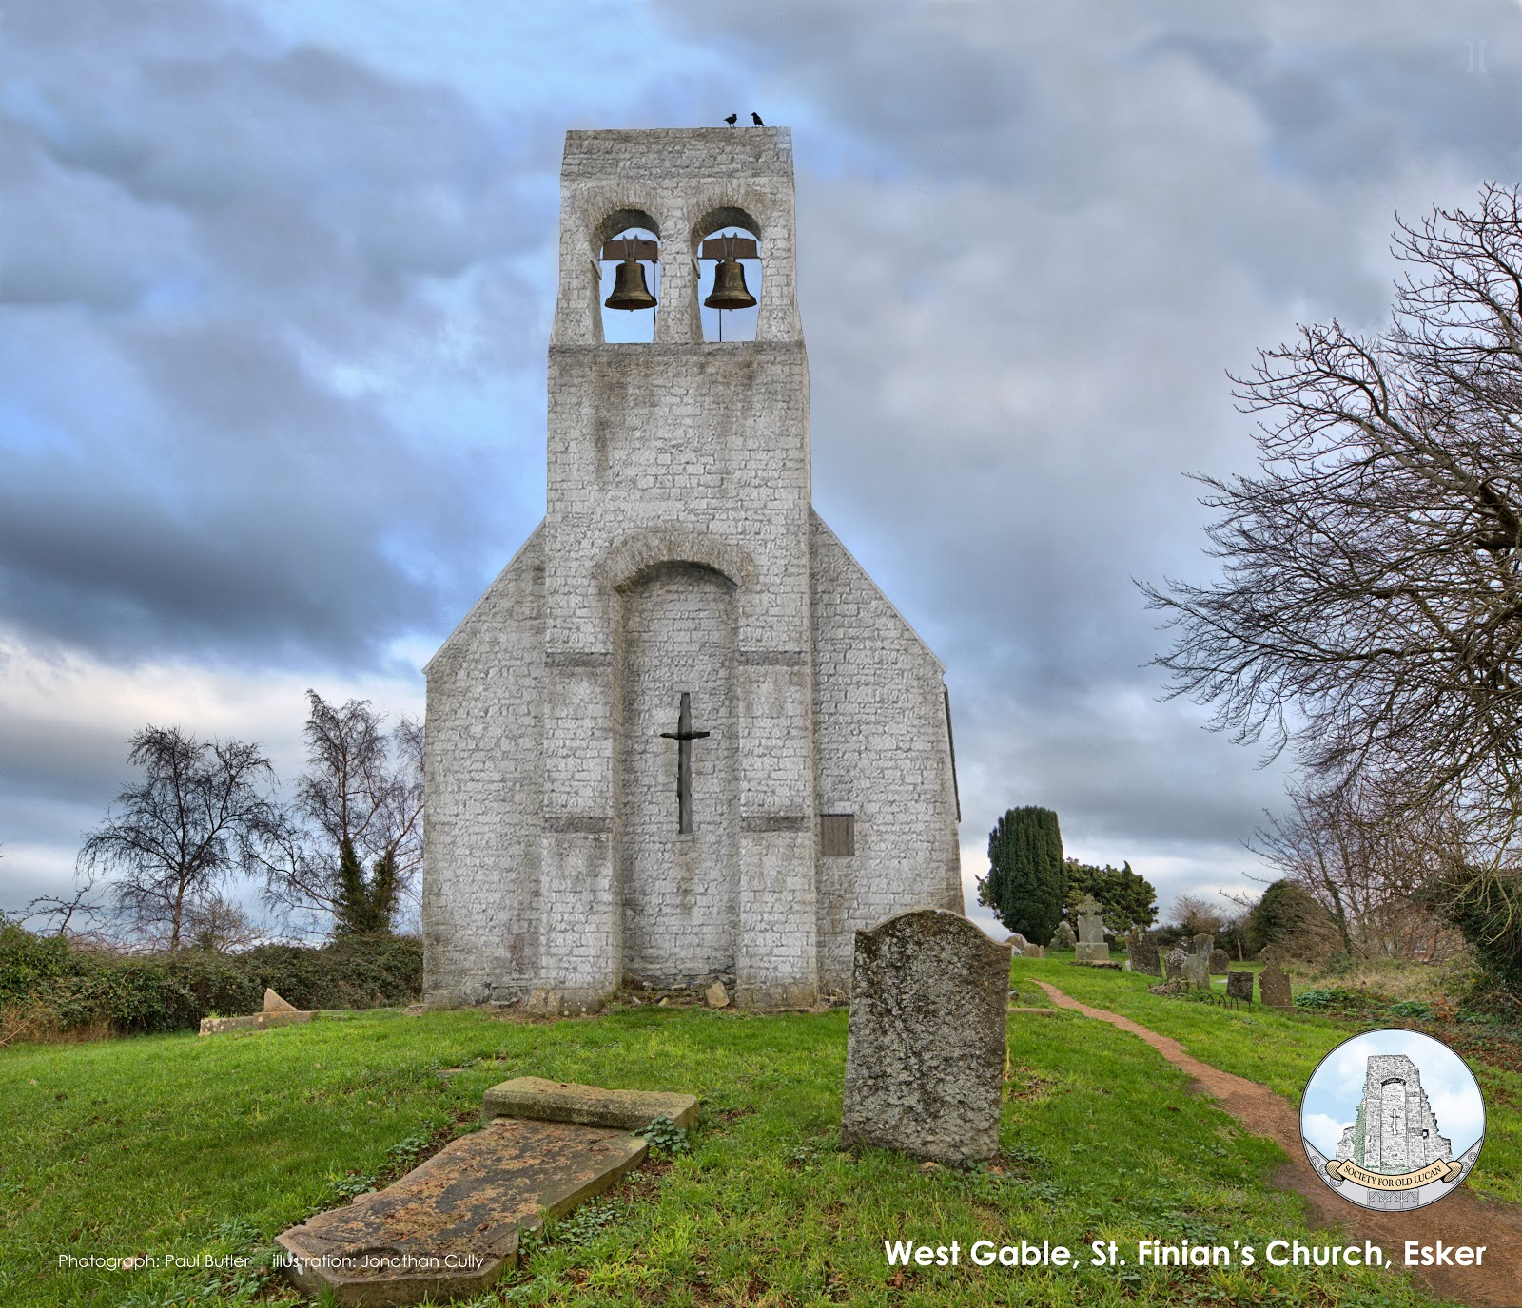
History of Esker, St. Finian’s, and the medieval Royal Manor
© Helen Farrell, Society for Old Lucan (SOL)
@Soc4OldLucan

Slide 2
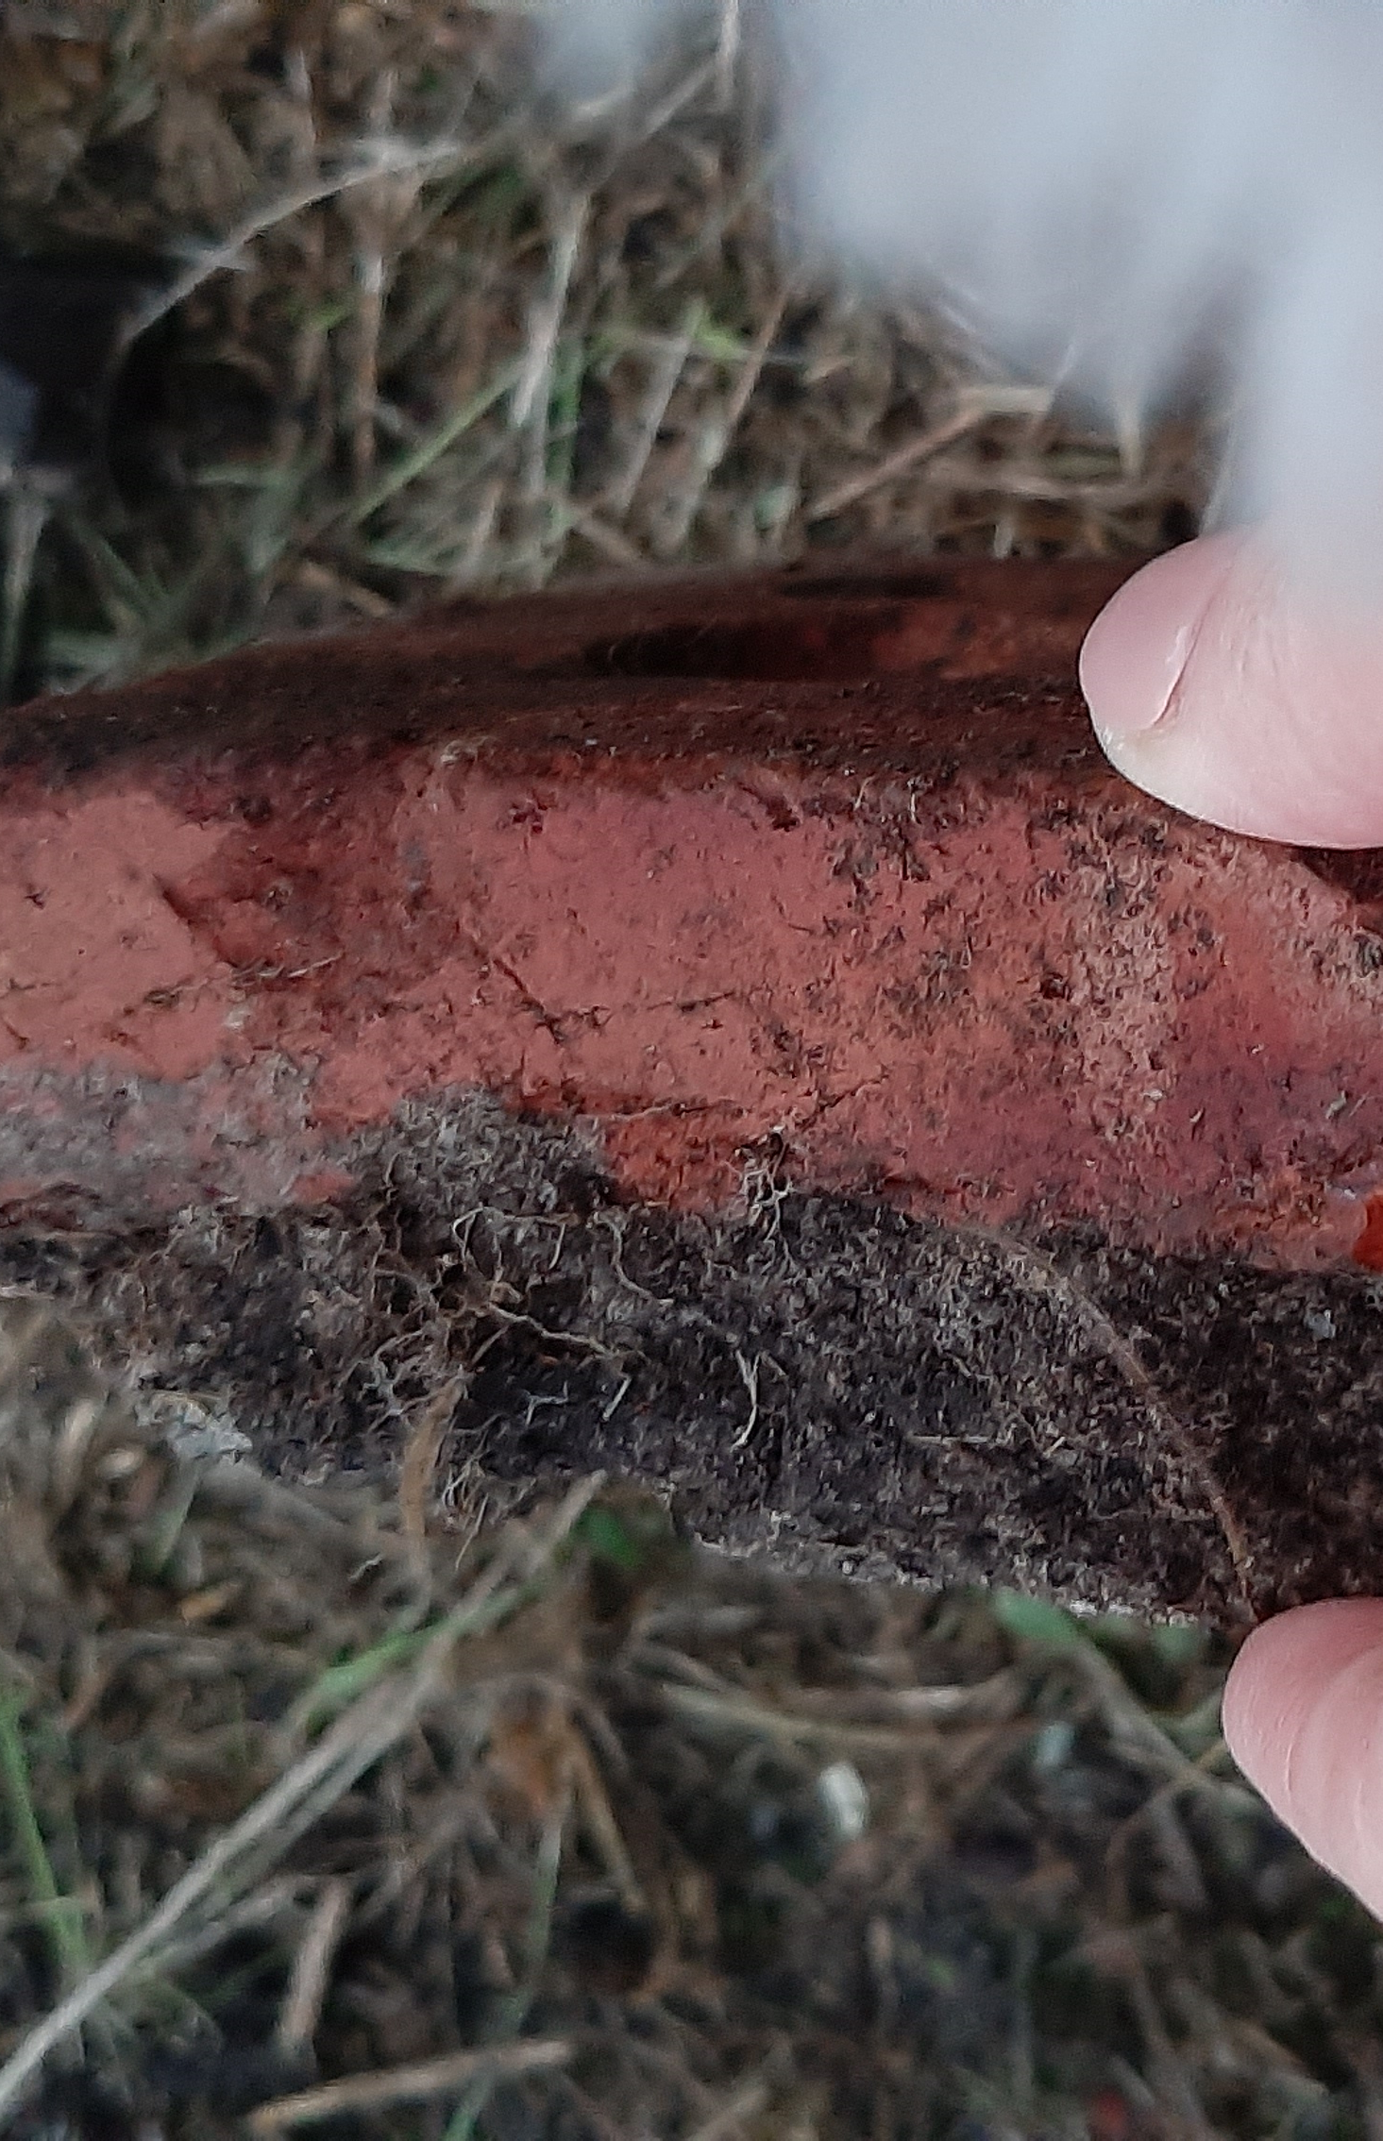
CONTENTS:
Introduction
The Royal Manor of Esker & the medieval court
The medieval King John’s Bridge, Esker
St. Finian’s medieval church & graveyard, Esker
Q&A

Slide 3
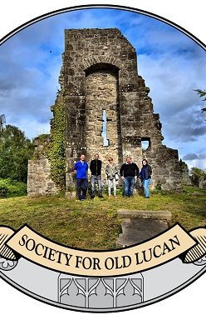
INTRODUCTION
Society for Old Lucan (SOL) founded in 2017, works to conserve, research and promote Lucan’s local history, heritage, archaeology and folklore.
All opinions and backgrounds welcome. Strong social justice & inclusion commitment; no fees. Fundraise for costs.
Over 2.6k followers on Facebook, active membership of over 150 individuals.

Slide 4
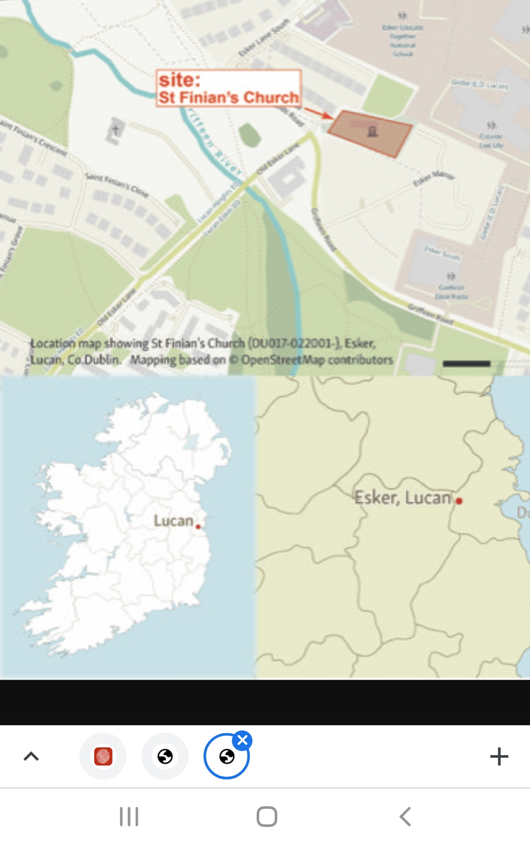
Thanks to the following SOL members for assistance with this research, in particular;
Paul Butler (drone & photography),
Jonathan Cully (digital imagery & research),
Elaine Hurley, Darren Tully, and Billy Sines (extensive research),
Owen O’Flynn and Audi Murray for letting us know about historical stories related to the sites, and
John Colgan (local historian in Leixlip who shared extensive historical information on Esker & Cooldrinagh .

Slide 5
ESKER BACKGROUND
Esker lies roughly 1mile SE of Lucan village, 4 square miles’ in area.
Civil parish (administrative) is very extensive with the following townlands: Ballyowen, Finnstown, Woodville, Ballydowd, Coldcut, Kishogue, Hermitage, Esker South, Esker North, Glebe, Rowlagh, St. Edmondsbury making up 2,500 acres?
An Eiscir as Gaeilge, and in English it has been spelled as: Esker, Eskyr, Eskir, Escar [Source: logainm.ie]
The esker comprises elevated areas of sands and gravels, made up of limestone clasts (very fine sand), which was deposited in a subglacial channel by meltwaters. Intact portions of the Esker (running NW/SW) adjacent to Esker Glebe in Griffeen Valley Park, and at Vesey Park near the Griffeen River.
The old Lucan-Newlands road that runs from the Circle K garage in Lucan village, past Esker cemeteries, past St. Finian’s and on to Newlands cross, runs along the top of the Esker.

Slide 6
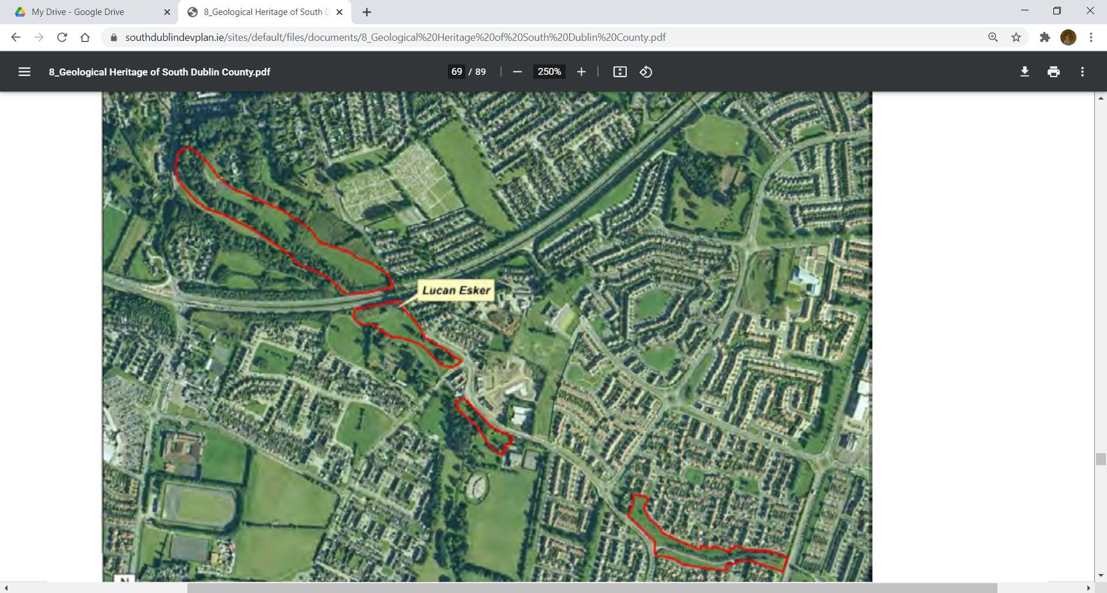
Screenshot from:
Hennessey, R [et al.]. The Geological Heritage of South County Dublin: an audit of the geological sites in South Dublin County, 2014. SDCC. (Source: https://www.southdublindevplan.ie/sites/default/files/documents/8_Geological%20Heritage%20of%20South%20Dublin%20County.pdf )

Slide 7
MEDIEVAL LANDSCAPE IN ESKER
Royal Manor, King John’s bridge and St. Finian’s church and near to the hillfort of Knockanardousk (with soutterain) about ¼ of a mile away. Sites are all atop the esker ridge.
1 mile from medieval Church of the Blessed Virgin, Lucan village, Lucan Manor, and the river Liffey, and 1.5 miles from medieval Church of St. Catherine.
“Esker of the seven churches” because the following guilds and church bodies owning land in the area during the middle ages:
St Mary’s Abbey, Dublin,
the Priory of the Holy Trinity (Christchurch),
St. Patrick’s Cathedral,
the Hospital of St. John the Baptist Without, Newgate,
the Guild of St. Anne in St. Audeon’s,
the College of Killeen, and
the church of Esker.
Lost placenames of Esker: Tirtillagh, Liscaille, Leaping Stones, Monangeragh, (recorded in 17th century, or earlier)
In mid-1600’s Esker’s population was 21 and surrounding townlands had similarly-sized populations
On Roque’s map of 1760 (next slide) there is evidence of manorial strip-farming surviving around the manor site.

Slide 8
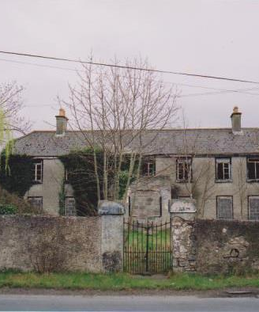
INDUSTRY ALONG THE GRIFFEEN & 1801
Remains of many small mills all along the Griffeen, evidence still visible. We know a medieval mill was owned by the wealthy Nottingham family, who owned Ballyowen Castle nearby.
River was re-routed in the 19th century, perhaps to facilitate milling, or landscaping by the owner of Esker Villa.
Esker had a cotton factory in 18th century, and milling & production of flax, iron, flock, and corn mills in Lucan, Leixlip.
Esker had quarries in 19th century, both of stone, and of fine sand from the esker.
Esker was the more important site, vs. Lucan, but the Act of Union, increasing industrialisation of Belfast, trade tariffs on Irish goods imported to the UK, all combined to caused the collapse of the early phase of Irish industry generally, and Esker depopulated.
In the early 19th century Esker also had a private Classical School for Boys adjacent to St. Finian’s church
In 1830’s Esker had just over 1,000 residents
Photo: Dave Power, SDCC Libraries

Slide 9
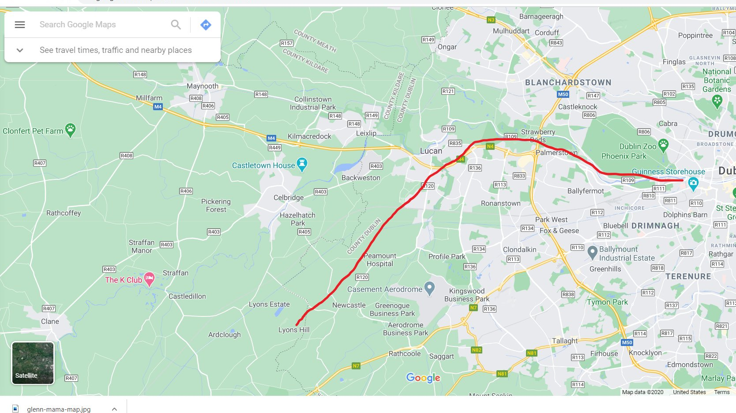
BATTLE OF GLENN MÁMA, (LIS)CAILLE & THE ANNALS OF THE FOUR MASTERS
Annals of the 4 Masters describes routing of Leinsterman & King Sigtrygg Silkbeard Dublin's men thru land at St. Finian's medieval church, (Lis)caille. “[…] will be routed forth with victory Until it reaches beyond *Caille* (?) northwards, And beautiful Ath Cliath (Dublin) will be burnt After an irruption over Laighenmhaigh (Leinster plain) “
Likely they followed the Griffeen to the River Liffey, and on to Dublin where it’s recorded that many were slaughtered at fording points along the way https://bit.ly/3gWPeGr
Intriguing find of skeletons of women & children in a field in the Strawberry Beds in the 1970’s? They had been slaughtered, just N of the Liffey, dating to 1,000AD.

Slide 10
LISCAILLE
In 1229 King Henry conveyed two acres of his lands at Esker, called Liscayllagh or Liscaillah, located near the church, to William Fitz Guido, Dean of St. Patrick's Cathedral, and his successors under the title of Canons of Esker.
Lios = Earthen ringfort
Caille = Veil / Nun
Caill in Old Irish = forest and “Caille” would likely be the genitive of “Caill”?
Is it possibly the “Ringfort of the forest”?
It is roughly 2 acres in size; can we identify it now from older maps and landholdings?

Slide 11
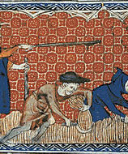
ROYAL MANOR OF ESKER
The demesne of the English Crown was made up of 4 Royal Manors in medieval times in Dublin: Tallaght, Saggart, Crumlin and Esker.
Tenants leased land from the Crown; feudal system.
Manorial village had Socage (free) tenants (Anglo-Norman/English names), farmers and poor tenants.
The revenues of these were sometimes given towards the defence of the Pale "against the Irish Enemie". In the thirteenth century there was a manor house close to the Church of Esker. In 1229 King Henry conveyed two acres of his lands at Esker, called Liscayllagh or Liscaillah, located near the church, to William Fitz Guido, Dean of St. Patrick's Cathedral, and his successors under the title of Canons of Esker.
We know some of what Esker Manor was like in the 16th century as the “Extanta Terrarum de Esker” describes the layout, residents and land-holdings.
Esker Manor had a mill.
Probably had the administrative centre and major landholders, with tenants living in other nearby townlands such as Ballyowen and Finnstown

Slide 12
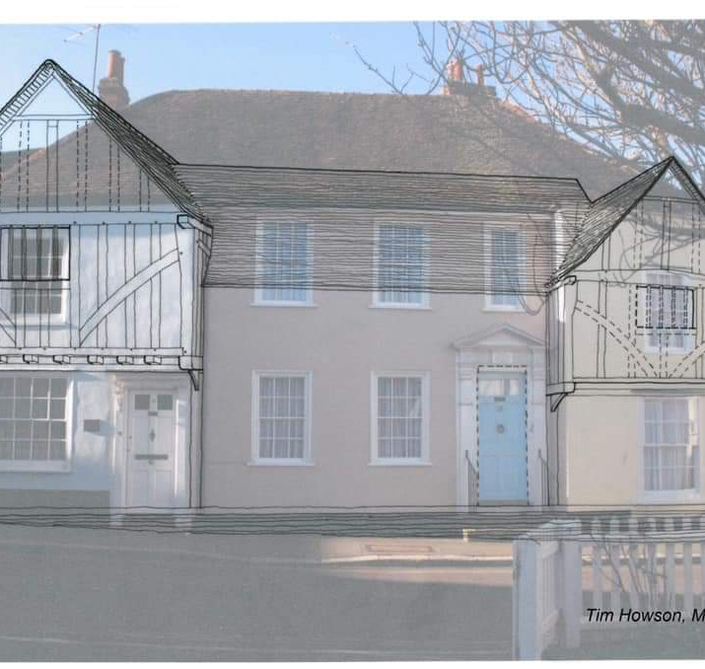
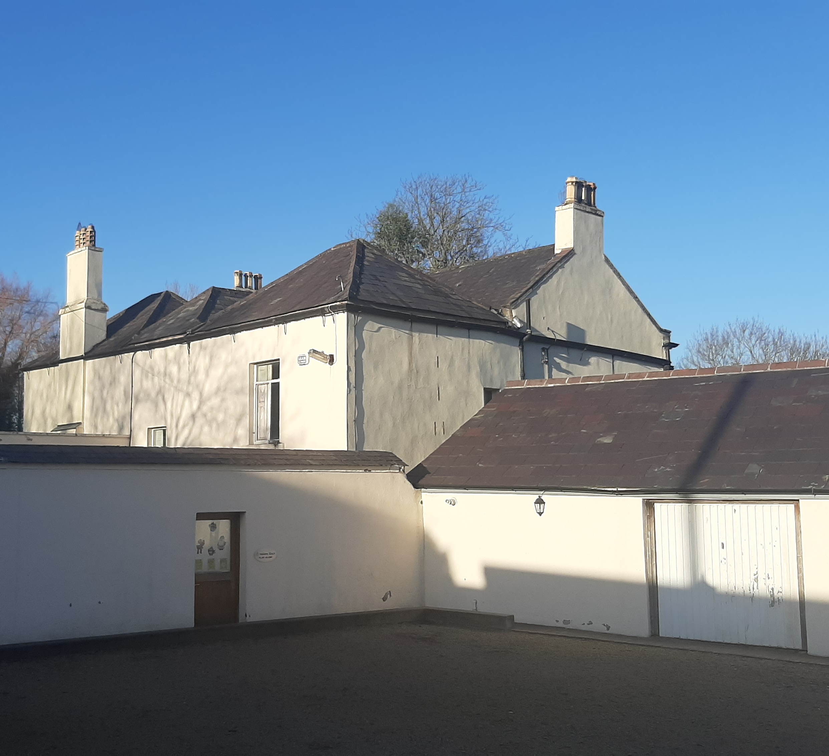
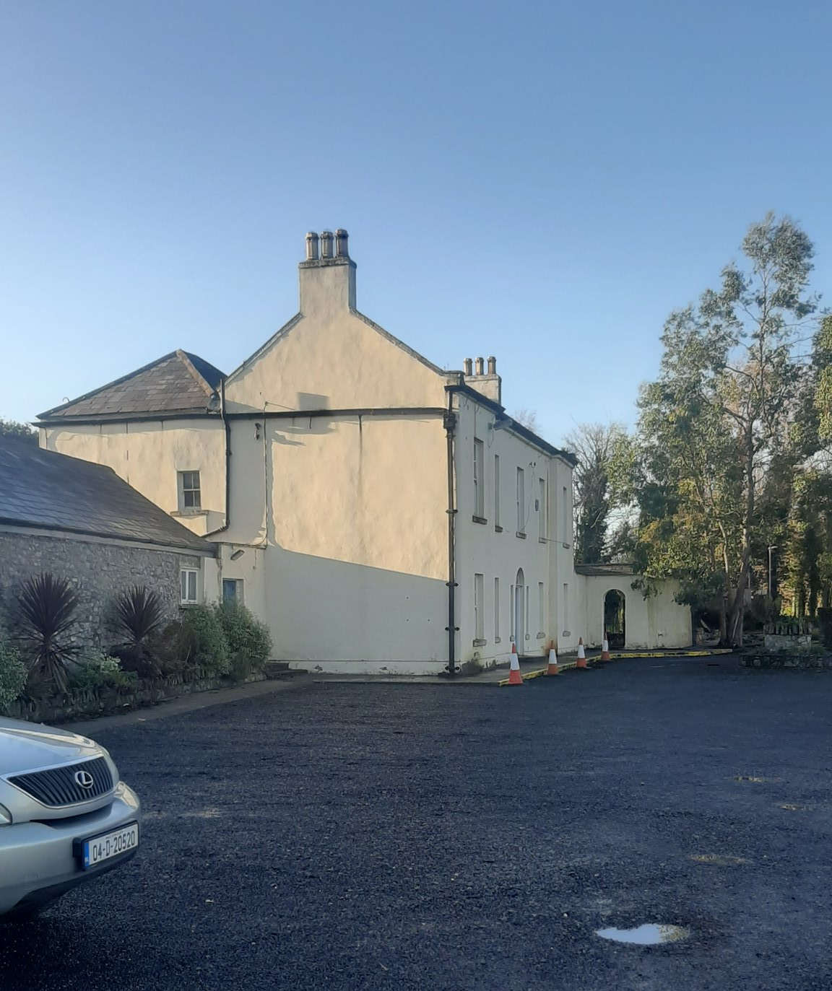
ROYAL MANOR OF ESKER
House was converted to a Georgian form in 1700’s and a wing added, but it is likely that the fabric of the medieval royal manor house remains standing, much like the example of the medieval Finnstown castle perfectly preserved within the Georgian Finnstown House.
Dr. Áine Foley, historian & author of The royal manors of medieval Co. Dublin: crown and community has identified possible medieval fish ponds in front of the house, on the banks of the Griffeen river.

Slide 13
ROYAL COURT OF ESKER
The court was believed to have been held at the manor house.
Curtis, Edmund. "The Court Book of Esker and Crumlin, 1592-1600." The Journal of the Royal Society of Antiquaries of Ireland, Sixth Series, 19, no. 1 (1929): 45-64. http://www.jstor.org/stable/25513505, gives us some examples of the cases that were heard during Elizabethan times. *
Ranged from stealing theft, boundary issues, attacks, unpaid bills and disputes around inheritance.

Slide 14
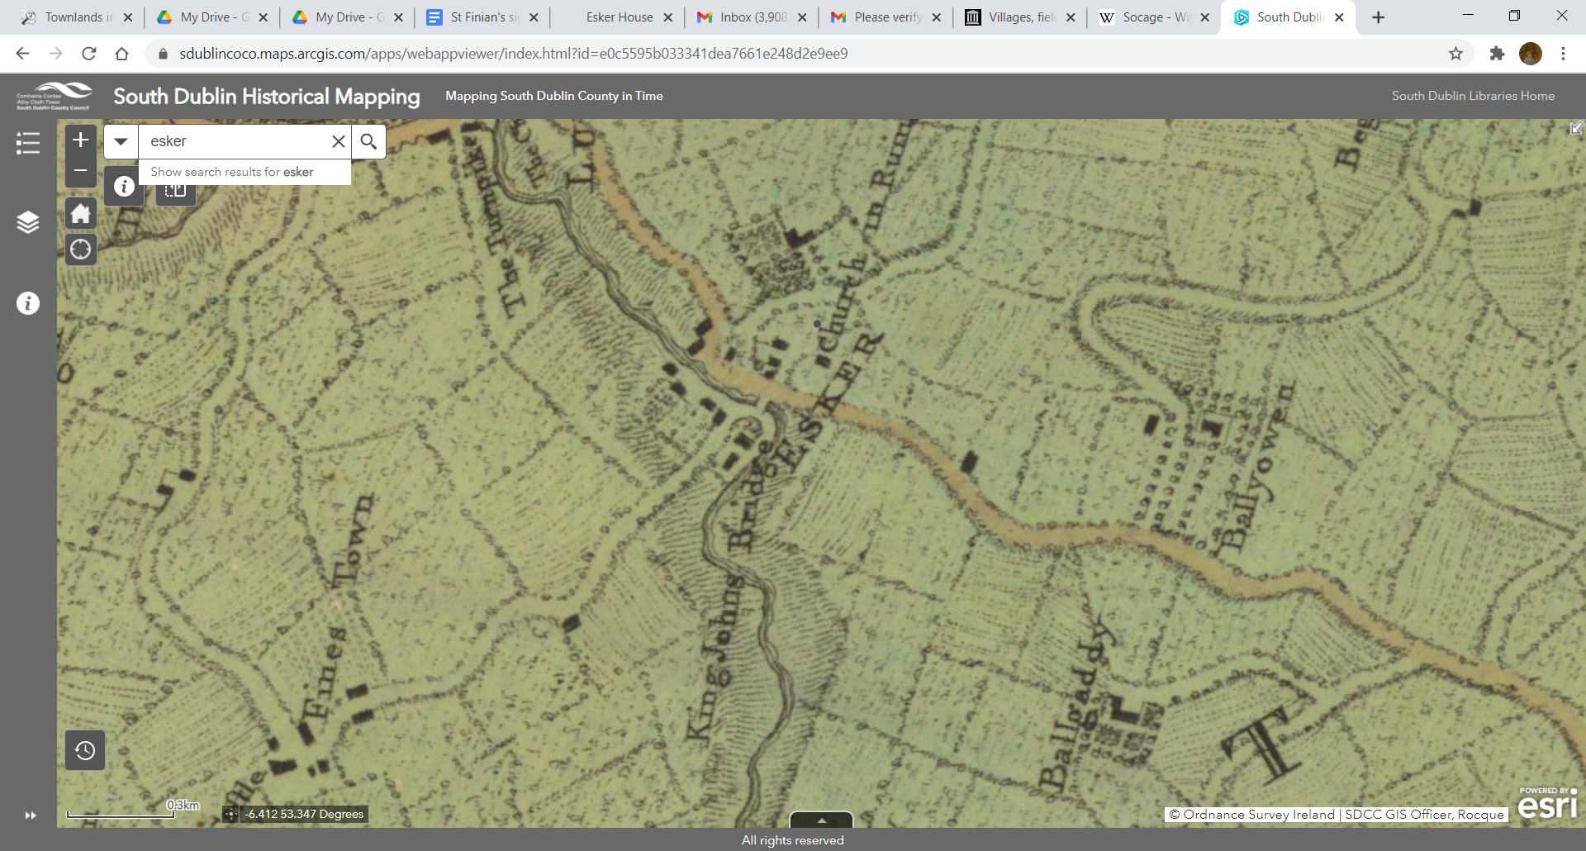
roque 1760 [SOURCE: SDCC HISTORICAL MAPPING]

Slide 15
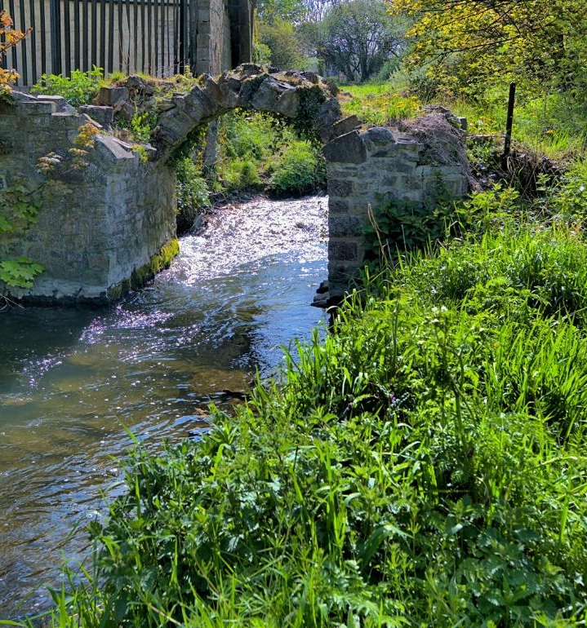
KING JOHN’S BRIDGE
Other “King John” bridges in the area, one at the Weir at Lucan village and one in Cooldrinagh.
Originally a 3-arched bridge
Only the arch-rim of one of the arches remains standing and it is in a perilous condition.
SDCC undertook some work to kill off an invasive sapling in the last 2 years.
Reconstruction of the remaining arch is crucial.
[Photo: Paul Butler, SOL]

Slide 16
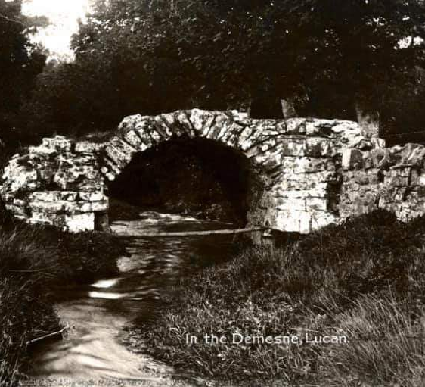
KING JOHN’S BRIDGE – 100 years ago

Slide 17
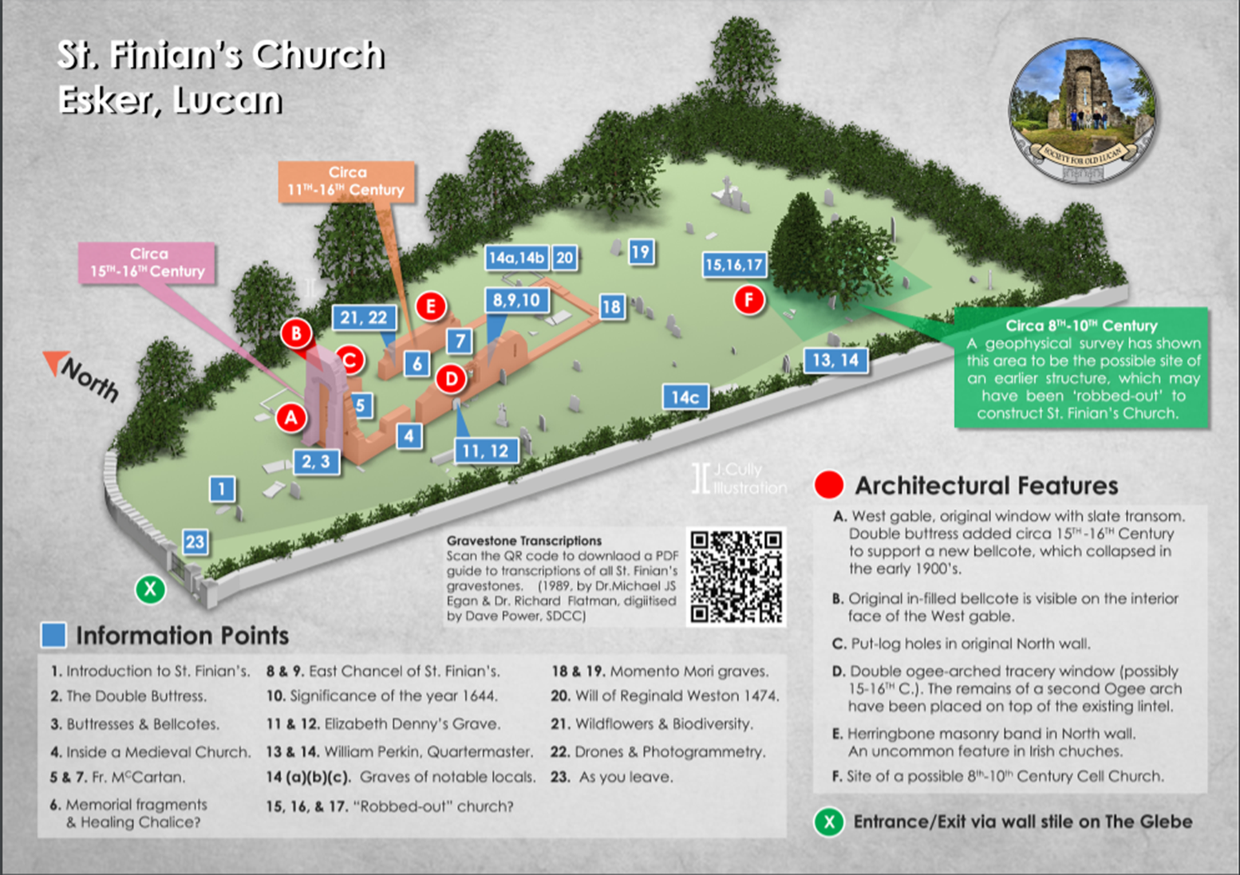
Designed by Jonathan Cully, SOL. © for Heritage Week 2020.
Use the QR code to link to the gravestone transcriptions, SDCC Libraries.
View the full presentation focusing just on St. Finian’s here:
https://www.heritageweek.ie/projects/st-finians-medieval-church-esker-collaborative-research-and-virtual-recreation

Slide 18
ST. FINIAN’S OVERVIEW
In June 2019 St. Finian’s was chosen as the first Dublin monument, in the “Adopt a Monument” scheme, run by the Heritage Council and Abarta Heritage
SOL is in the middle of a 3-year plan for St. Finian’s, working with the site owners, SDCC. So far we have completed archaeological surveying and conservation reports in 2019, kindly funded by The Heritage Council and Creative Ireland. In 2020, SDCC sourced funding from the Community Monument Fund, National Monuments Service, for urgent repairs to the structure, and SDCC contributed additional funds to complete these repairs. SOL paid for repairs to the decorated 15th C window on the South wall, by using crowd-sourced donations from SOL members.
Family members still visit the graves, with many Lucan families buried there who have been connected with the area for generations; Graham, Barnwall, Hanbury (Hanbury Lane in Lucan village), Merriman.
Date for the major part of the church as you see it now is roughly 12-15th century, but the site is older and a portion of the North wall is 10th century or older. Commonly described as being built in 1150, but this is problematic.
Dimensions:

Slide 19
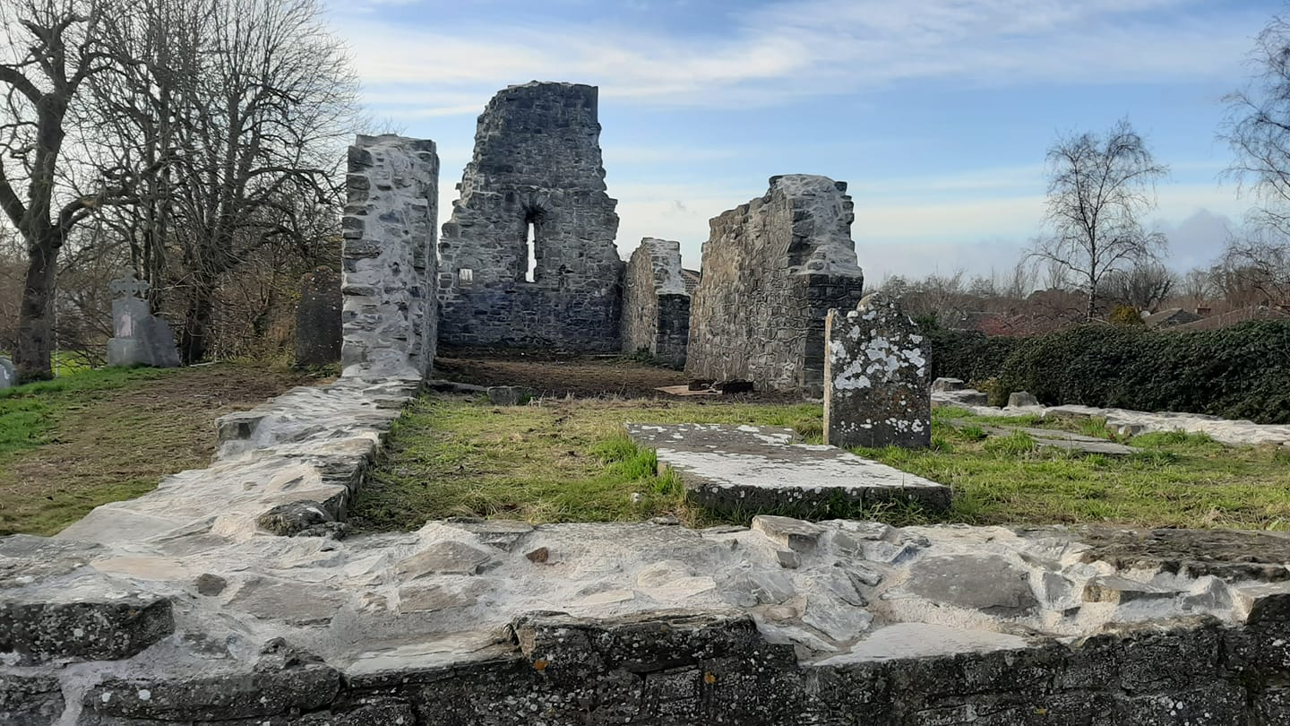

Slide 20
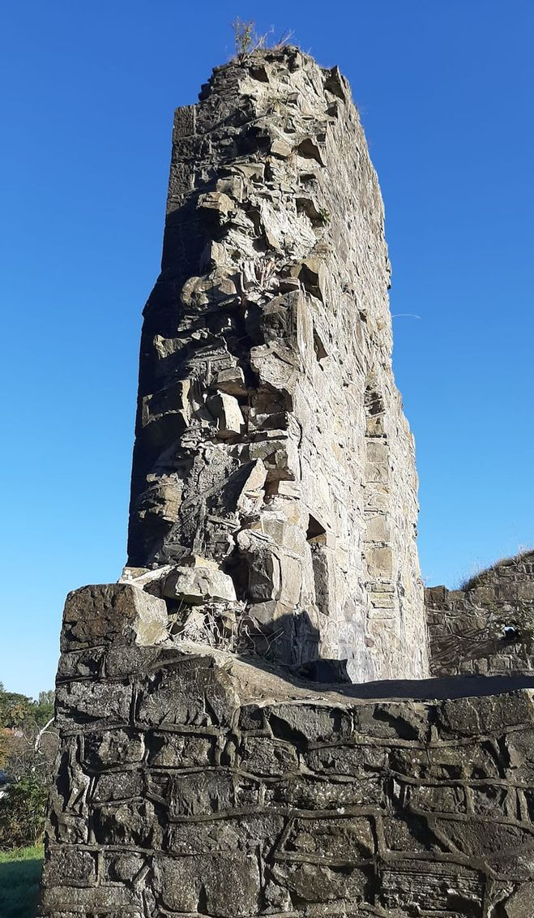
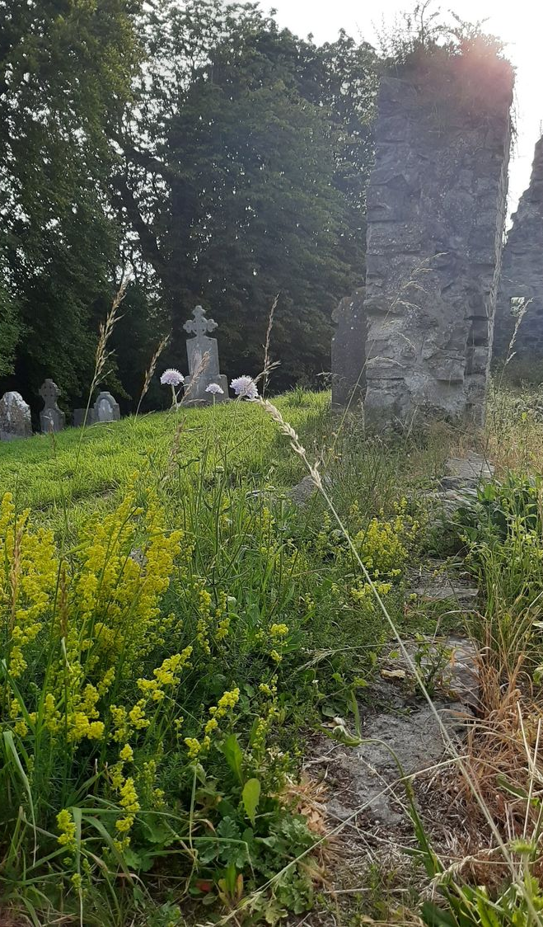
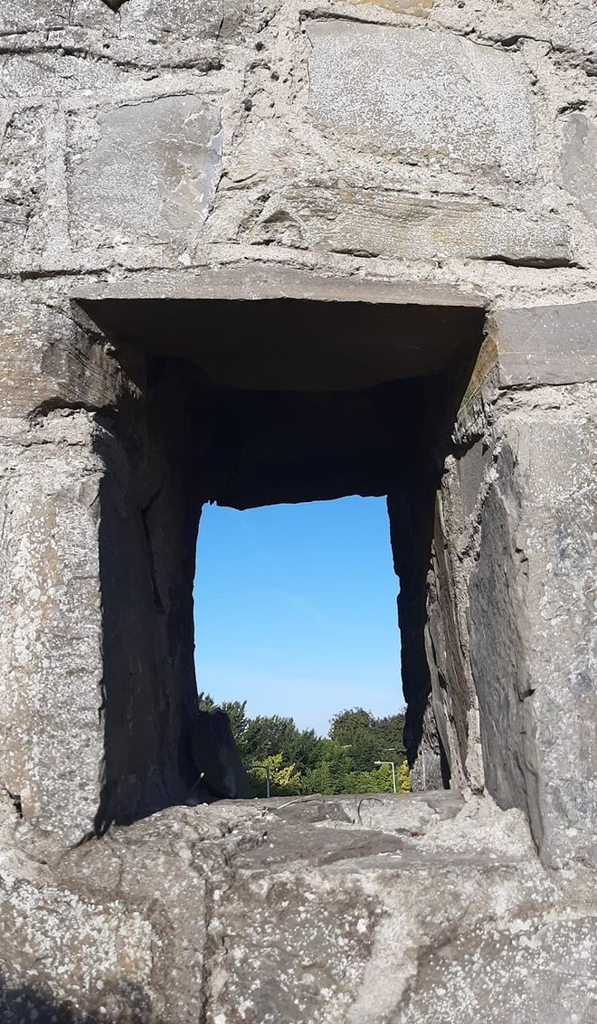

Slide 21
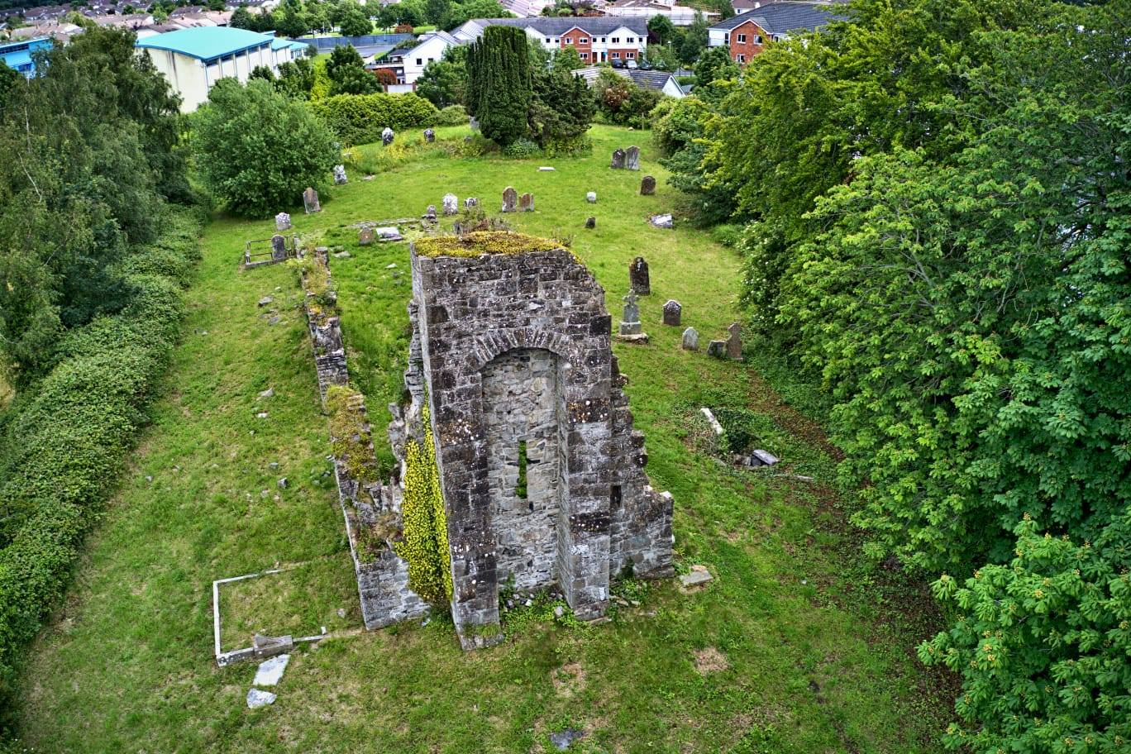

Slide 22
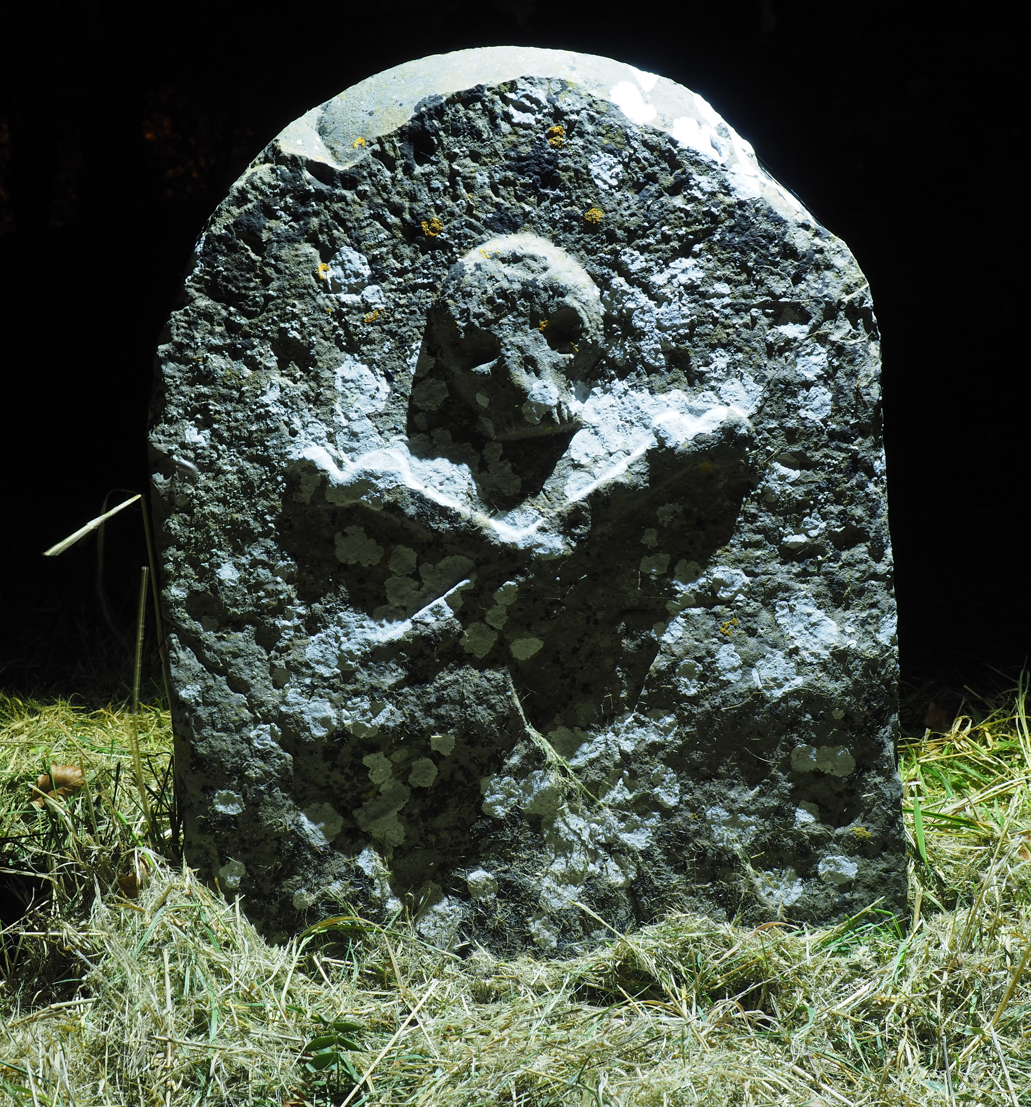
GRAVESTONES OF ST. FINIAN’S
Roughly 60 visible
Oldest known standing grave is that of Thomas Talbott in 1718 with a striking skull & crossbones on the E. side.
“You are taken inside the walls of the old ruin, and a stone is shown to you in which there is a cavity " cut in the shape of a chalice." The cure involved putting their fingers in the water that lies in the chalice, and rubbing their eyes with it." On another stone nearby you are shown a cavity called " The Devil's Foot," and informed that " if anybody puts his hand or his foot into that hole it will stick there”. “ [Source: Mac Cárrthaigh, Deasmhumhan. "Gleanings from the District of Lucan." Béaloideas 12, no. 1/2 (1942): 127-33. Accessed March 21, 2021. doi:10.2307/20522028.]
[Photo credit: Stephen Callaghan, SOL]

Slide 23
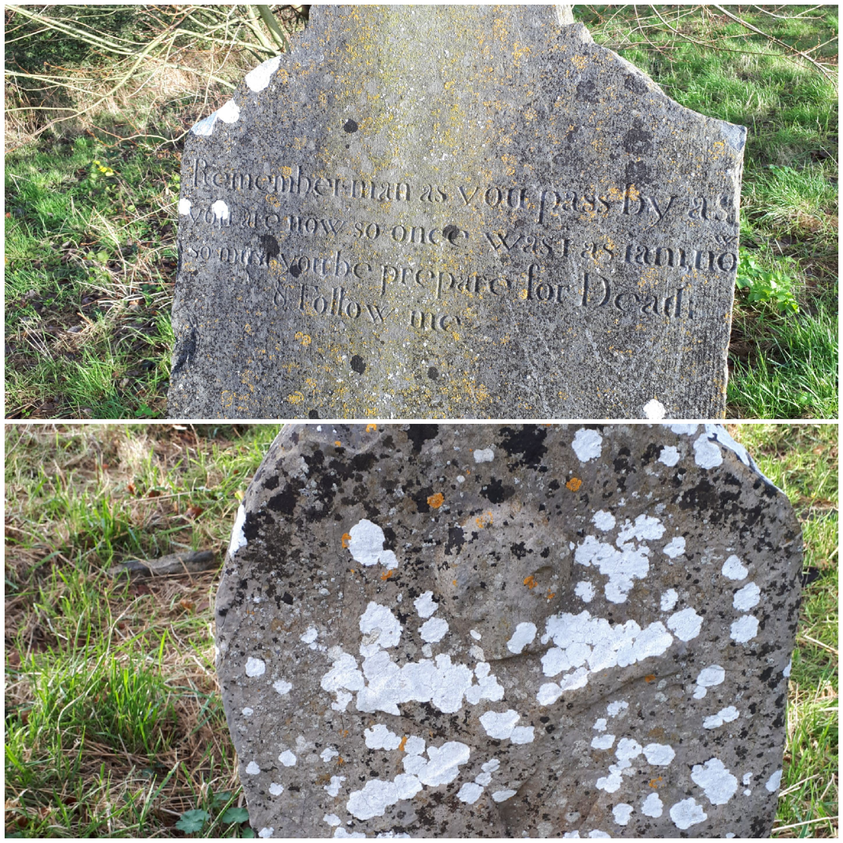
OTHER GRAVESTONES
Remember man, as thou pass by, As you are now, so once was I, As I am now, so will you be, Prepare for death and follow me.“
- from the grave of John Jacob, a dealer in the Ormond Market in the city of Dublin who erected the grave in memory of his ancestors, and who died in 1776.

Slide 24
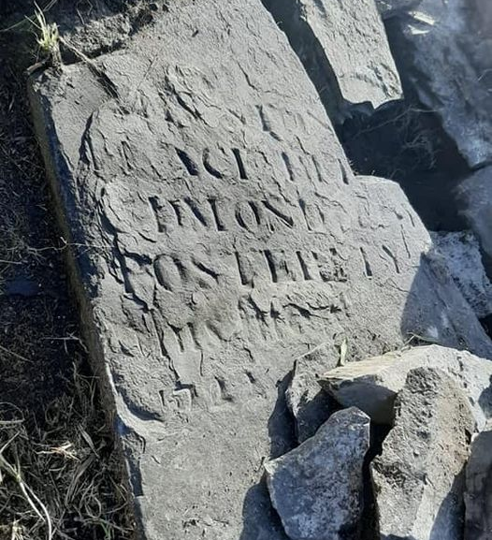
LOST & FOUND
Expert removal of loose stone revealed this gravestone fragment in the South wall.
We believe this was erected for Edmond Coyle who died in 1722. That potentially makes it one of the oldest surviving memorials on the site.
A 1989 graveyard survey suggests the memorial stone was still standing at that time. Later repair work saw the fragment added to the wall for safekeeping.

Slide 25
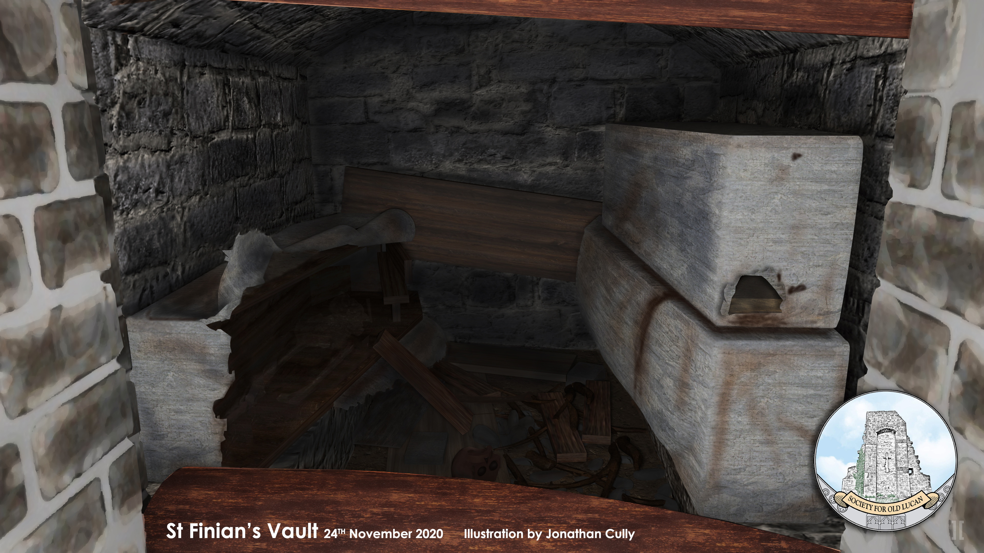
THE VAULT
3 lead coffins inside: not known yet who is buried in the vault.
Clergy?
Identical in design to the vault built in the graveyard of the Blessed Virgin Mary, Lucan village (behind O’Neill’s pub), which blocks an 18th C doorway into a church.
Vandalised in 1990’s.
Reconstruction of the vault by Jonathan Cully.

Slide 26
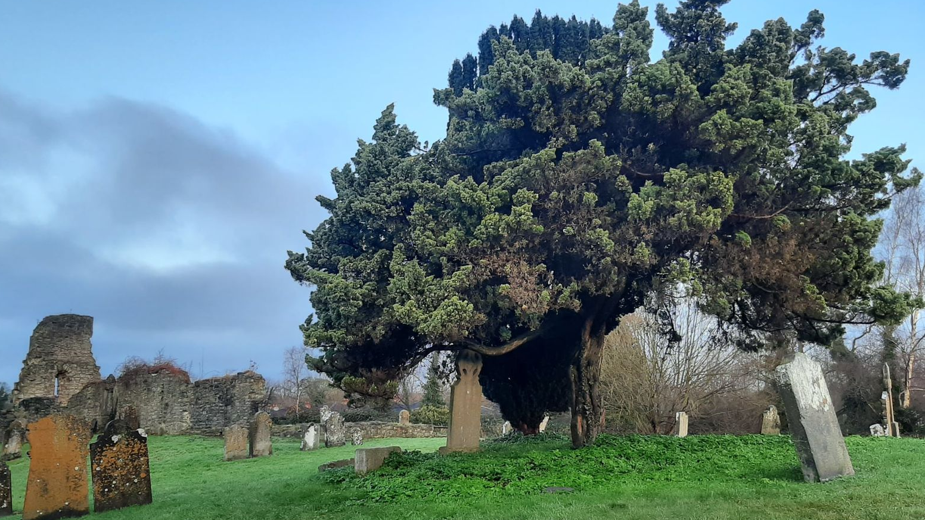
ST. FINIAN’S IN EARLIEST MEDIEVAL TIMES
Geophysics – earlier structure & possible lych-gate?
Herringbone
Vikings in the area (Clondalkin & Leixlip) but no archaeological evidence in Lucan yet (most of the sites are in private ownership)
Nearby medieval site of Knockanardousk in the glacial valley behind Vesey Park (Iron Age hillfort / medieval ringfort with souterrain)
Other medieval churches nearby Aderrig, Lucan and Church of the Blessed Virgin, Lucan village

Slide 27
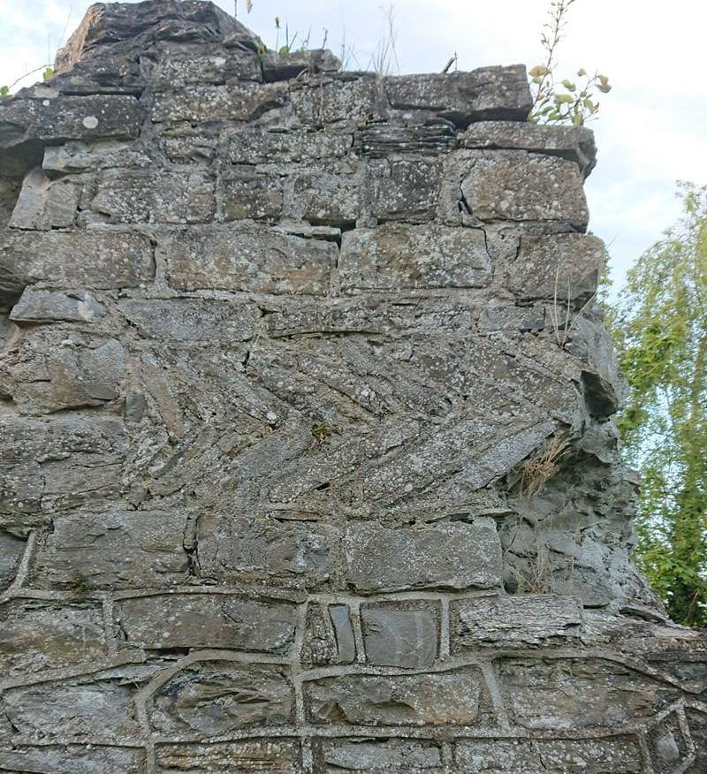
SOMETHING FISHY GOING ON…
Band of herringbone masonry on the interior of the North wall of the nave.
It has been identified as pre-Anglo Norman in date.
10th century, or older, in the English masonry tradition.
Often found on Saxon churches.
Mystery as to why it was used?
Also found on only 1 other Irish church, Killadreenan, Co. Wicklow on the exterior N wall.
Found in a church on the Isle of Man on the interior, like here.

Slide 28
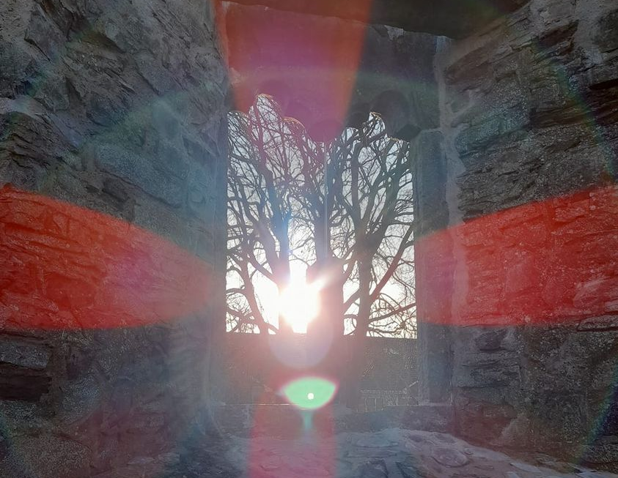
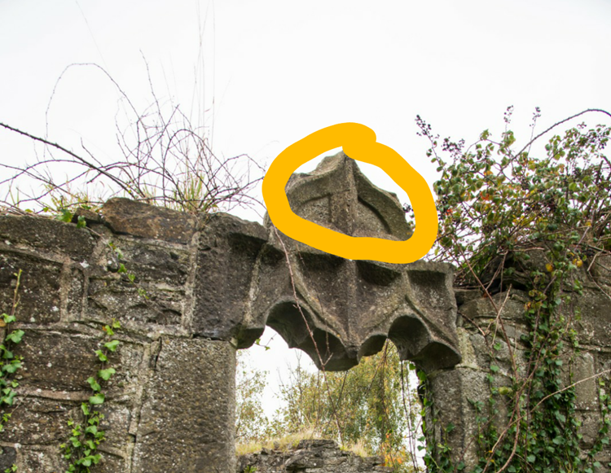
ST. FINIAN’S MEDIEVAL ARCHITECTURE
Remnants of a chancel arch
Ogee-arched double-lighted window, 15th C
Nothing of the East end remaining above first 3 courses.
Probable residential tower in the West gable, as walls are exceptionally thick and the put-log holes suggest a floor, and possible staircase.
Graves of the clergy in the church interior; Anglican and Catholic
Ruined since 1700’s
Reconstruction has made identification of the original door dimensions a challenge, but during conservation works last year, moulding from a medieval door was discovered in the vicinity of the North door.

Slide 29
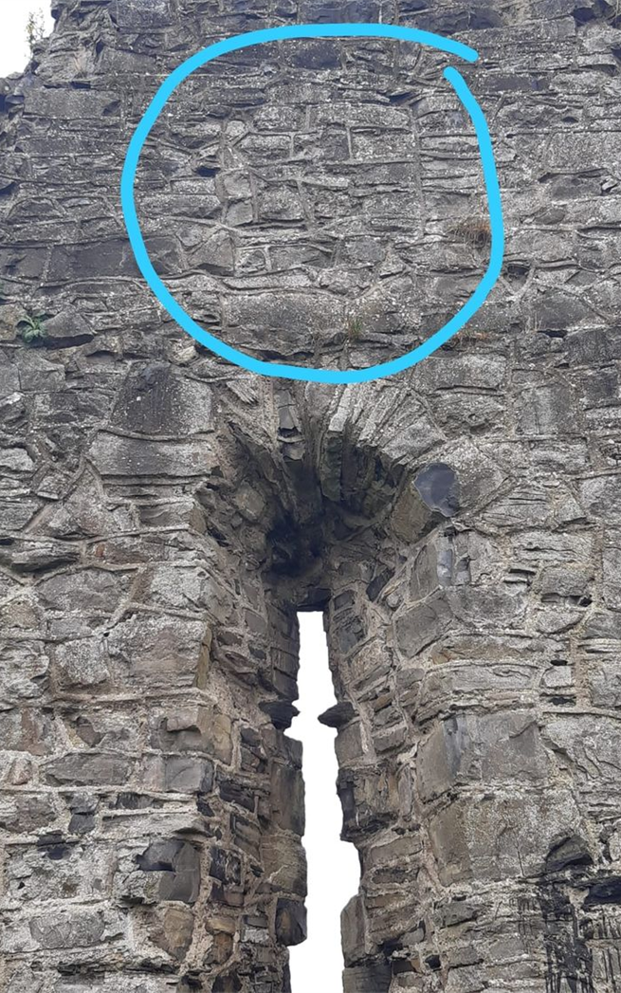
ST. FINIAN’S – 13TH CENTURY – 15TH
Whatever church existed on the site of St. Finian’s prior to the Anglo-Norman conquest in 1179, they remodelled it extensively in the 13th century.
Very Anglo-Norman in form
Nave-and-chancel type church.
St. Finian’s under ownership of Dean of St. Patrick’s cathedral
15th century additions; buttress, ogee-arched windows.
We have some legal conveyances and cases during this time *

Slide 30
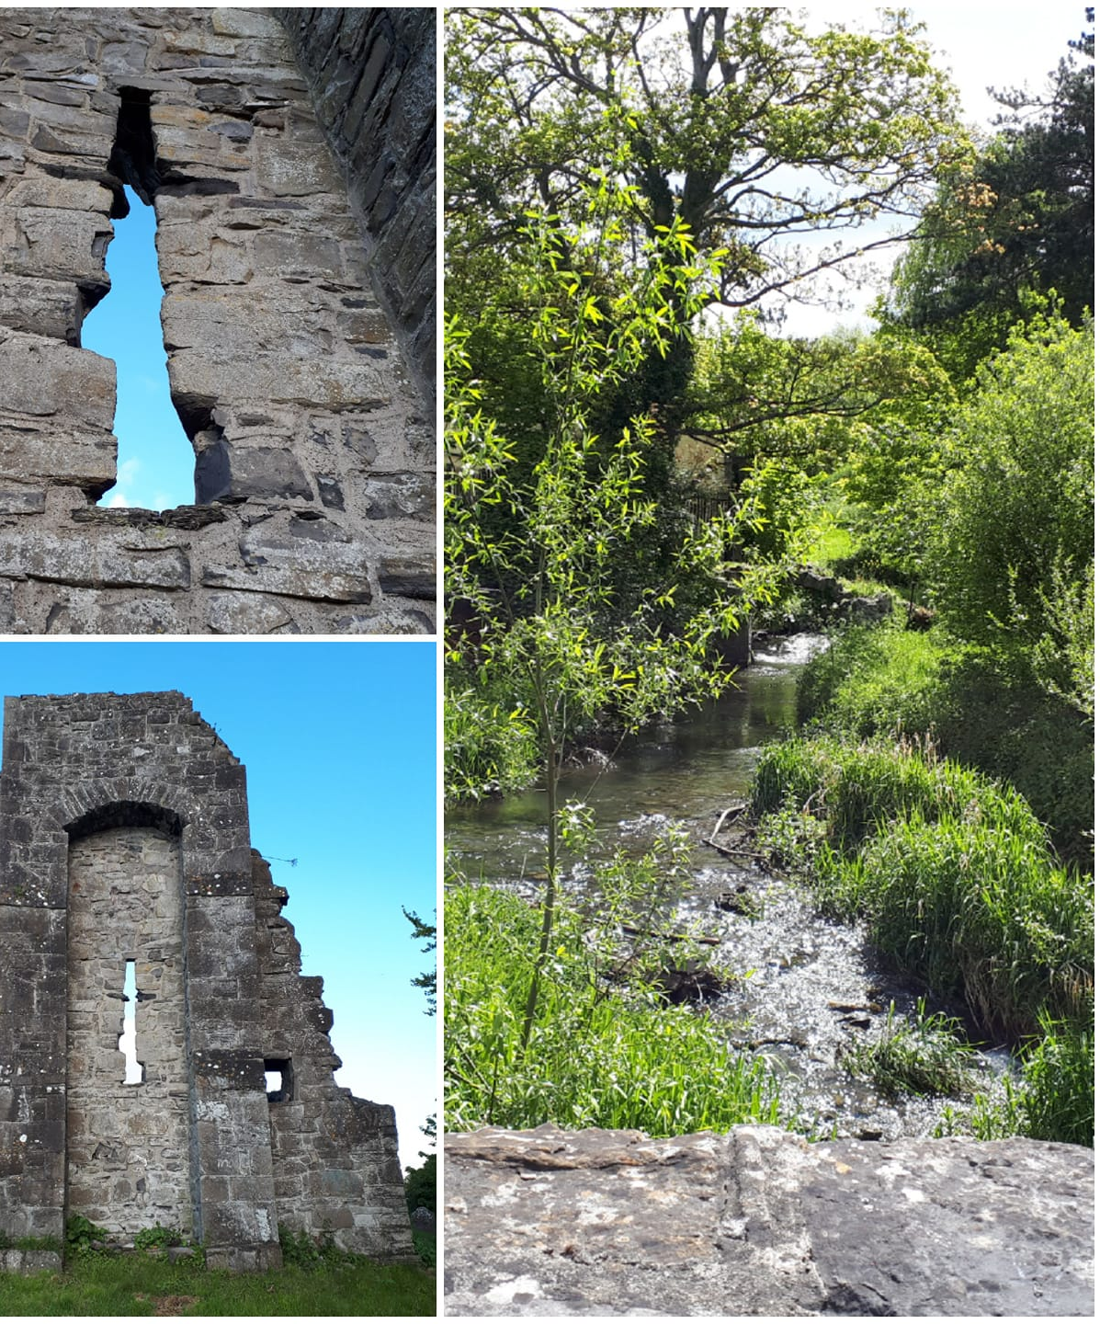
A WILL FROM THE 15TH CENTURY
A will made by Reginald Weston dated the fourth day of December, 1474, one of a series of wills (transcribed from the Medieval Latin), published in 1889, in the register of wills and inventories for the Diocese of Dublin for the years 1457-1483.
Reginald and his wife, Alice Yong, are listed with an inventory of goods, including 13 acres of wheat and barley in the fields, 30 sheep and 5 cart horses. Reginald states:
‘In the name of God. Amen. I, the aforesaid Reginald, being sound in mind though weak in body, do make my testament in this manner : first, I bequeath my soul to Almighty God, the Blessed Virgin Mary, and all the Saints, and my body to be buried in the cemetery of St, Finian, the bishop, at Esker’.
He bequeaths items to the churches at Esker and Palmerstown, and assigns his wife and his daughter as executrices of his will.
(Register of wills and inventories of the Diocese of Dublin in the time of Archbishops Tregury and Walton, 1457-1483: from the original manuscript in the library of Trinity College, Dublin by Royal Society of Antiquaries of Ireland; Barry, Henry Fitz-Patrick, 1898, Publisher Dublin: University Press for the Royal Society of Antiquaries of Ireland) https://archive.org/.../registerofwillsi00roya.../page/88...
[Photo & information: Elaine Hurley, SOL]

Slide 31
ST FINIAN’S IN 17-19TH CENTURIES: 2 of 2
Oral history https://www.duchas.ie/en/cbes/4428212/4386287 says that Cromwell "destroyed St. Finian's" in the 1650's, but there is no other known historical evidence for Cromwell's soldiers in Lucan. One story is that Henry Ireton and his soldiers may have “visited”. It is an intriguing avenue for further research.
Certainly, the Eastern end of churches tended to be obliterated by Cromwell's soldiers, as the East traditionally contained the chancel (alter/rood-cross/vestry), often with the most decorated window in a church, occasionally with stained glass.
By the early 17th century, St. Finian’s was ruined.
In 1779 an article in the newspaper complained about cattle grazing in the graveyard.

Slide 32
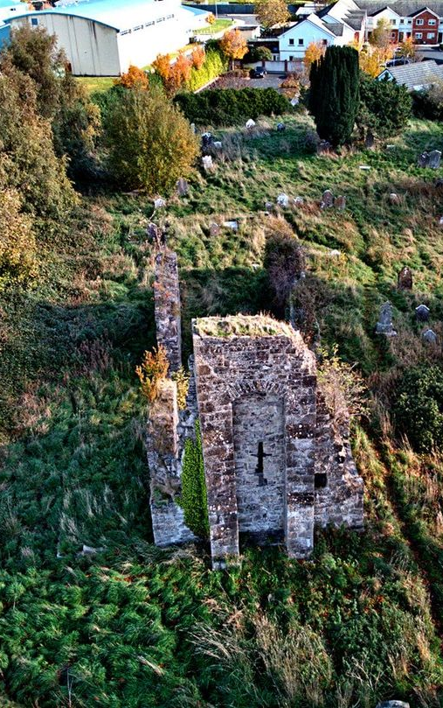
ST FINIAN’S IN 17-19TH CENTURIES: 1 of 2
Royal Visitation of Dublin, 1615
“Esker: Richardus Wiborow curatus. Vicarius deprivatus propter non residentiam. Vacua ergo sequestrantur fructus.” Curate is Richard Wilborow. Vicarage is deprived because of non-residence. Empty fruit???? ☺
[Source: Ronan, M. V. "Royal Visitation of Dublin, 1615." Archivium Hibernicum 8 (1941): 1-55. Accessed March 21, 2021. doi:10.2307/25485525.]
Archbishop Bulkeley's Visitation of Dublin, 1630
“ESKER. The church is altogether ruinous: nothinge upp but the walls. The great tythes belonge to the Deane of St. Patricks. The vicariadge by reason of the nearness of it to Clondalkan, is united to Clondalkan, the said Mr. Ware being vicar of both, whose meanes there ia worth xx libri per annum. Mr. Lamoruke Nottingham, of Ballyowen, is a principal abbettor and maintainer of preists and fryers in that parishe, who resort to his house. “
[Source: Ronan, M. (1941). Archbishop Bulkeley's Visitation of Dublin, 1630. Archivium Hibernicum, 8, 56-98. doi:10.2307/25485526]
1697 Act was passed in the Irish Parliament banning all papist priests from the kingdom *
[Photo: Paul Butler, SOL, St. Finian's , 2018. ]

Slide 33
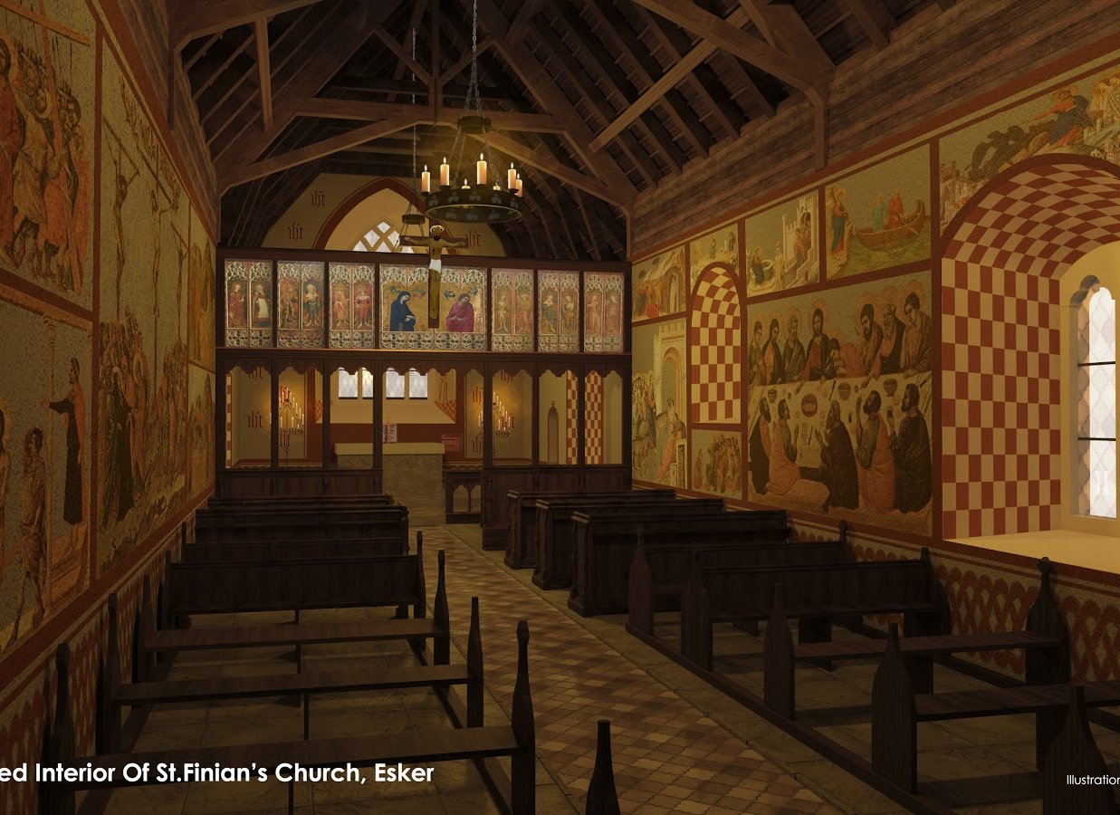
ST. FINIAN’S REIMAGINED
3D visualisations of St. Finian’s as it may have looked in medieval times, by Jonathan Cully (SOL) 2020.
Jonathan faithfully recreated the interior and exterior using existing examples from medieval churches around Ireland and the UK.
His presentation on the full process and historical & archaeological examples used is online: https://soc4oldlucan.files.wordpress.com/2020/08/stfinians-renders-1.pptx

Slide 34
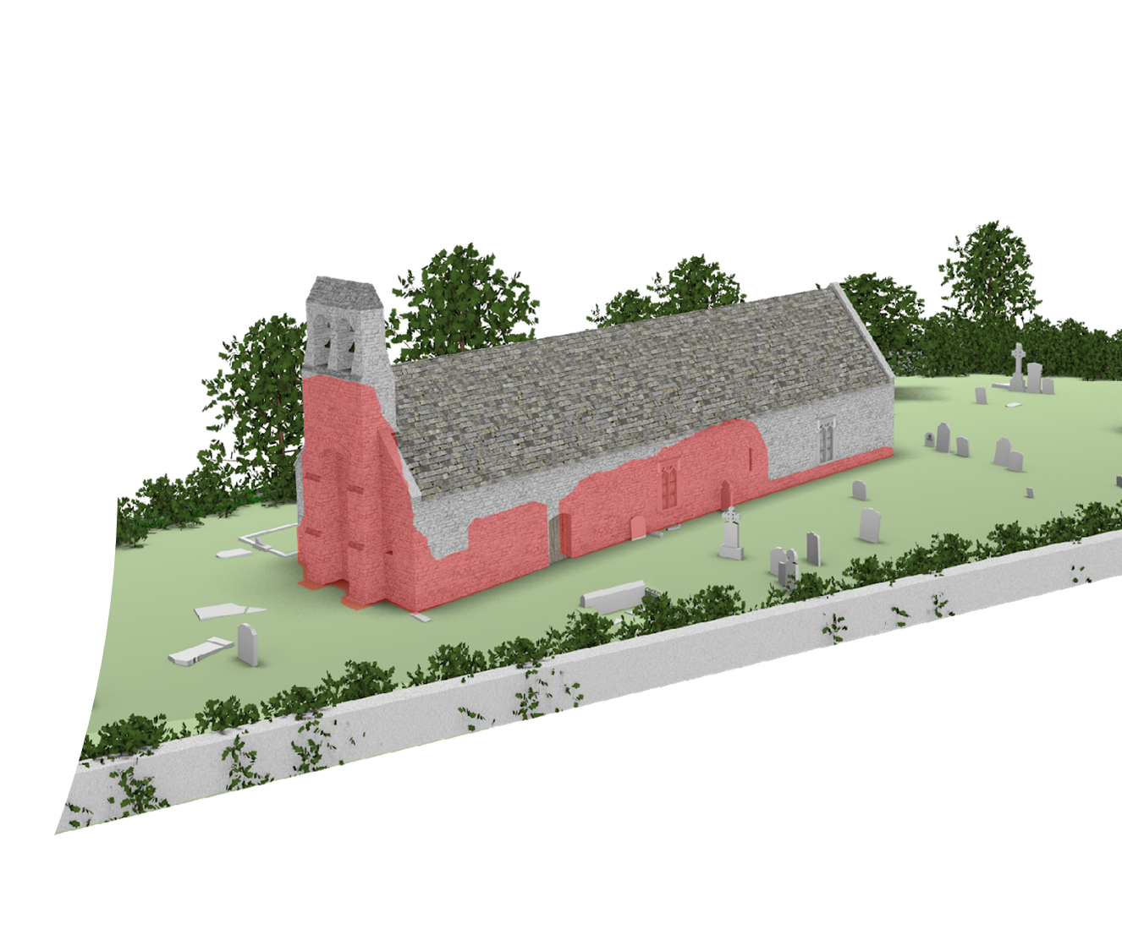
ST. FINIAN’S REIMAGINED
Jonathan Cully (SOL) 2020

Slide 35
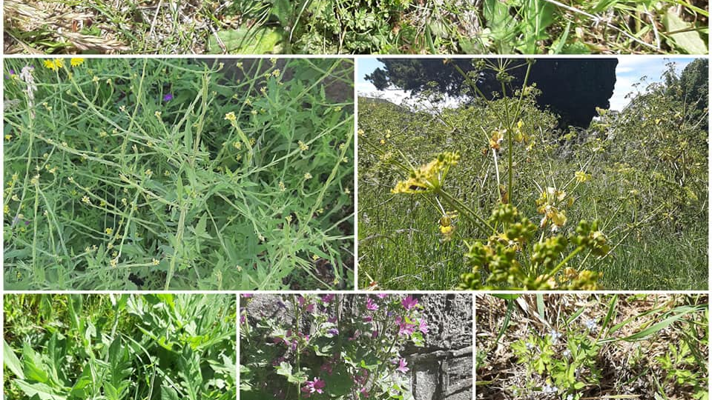
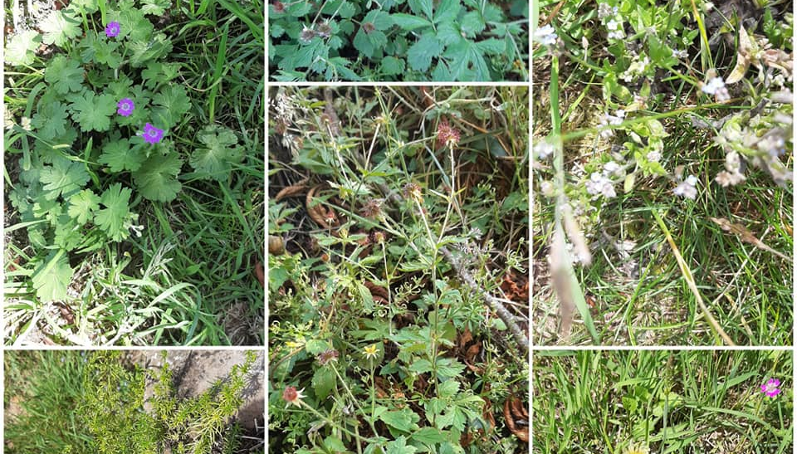
BIODIVERSITY
SOL have worked with SDCC to identify biodiverse areas within the graveyard and limit grass-cutting.
Biodiversity study planned for 2021.
Wildflower survey with SOL members planned for 2021 using LeafSnap App.

Slide 36
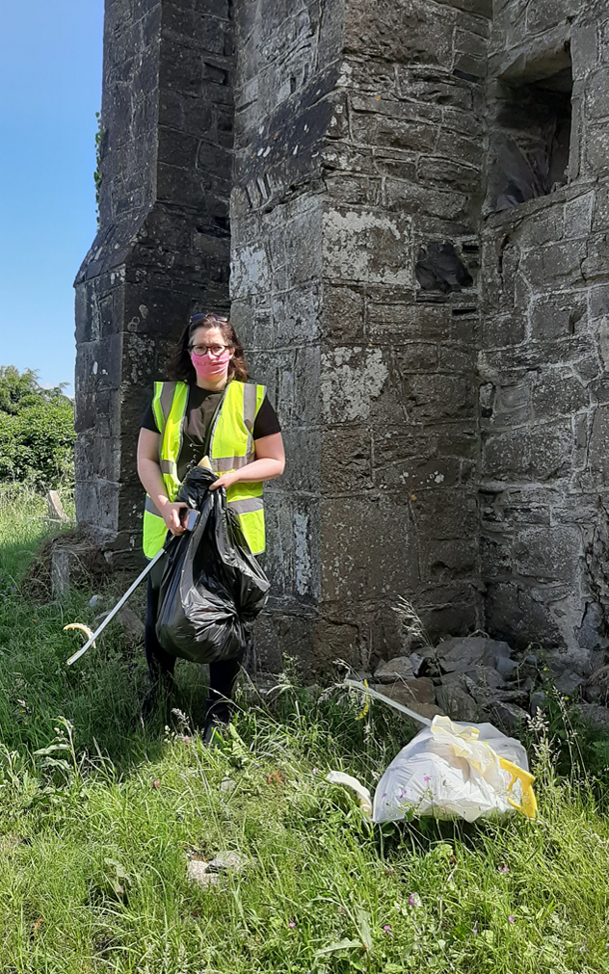
ST. FINIAN’S: THE PRESENT
In 1902 Fr. William Donegan wrote "... such magnificent ruins as those of Esker, dating so far back as the year 1100 are allowed to decay. It is earnestly hoped that the Board of Works will save them from their impending fate, and solidly reconstruct the ivy-mantled gable and walls, that they may remain to speak perennially to future generations the story of their hallowed memories of the past.” Source:http://www.archive.org/.../lucaniatopograph00done_djvu.txt
Adopt A Monument project continues.
Signage
Graveyard project: photogrammetry, transcriptions, photos, measuring & recording with volunteers.
SOL will continue to research and promote this site; we are finding out new historical and archaeological information all the time. We present our research to the public in free tours, digital reconstructions of the site, events during Heritage Week, and free online material. We work with local schools to promote awareness of our rich local history.

Slide 37

Q&A CONTACT INFO
St. Finian's Esker church site & graveyard, Esker, Co. Dublin Facebook page: https://www.facebook.com/stfiniansesker/
SOL website: https://soc4oldlucan.wordpress.com
Facebook group; search for “Society for Old Lucan (SOL)”
Twitter: @Soc4OldLucan
OldLucan@gmail.com

